Slide 1
COMPUTATIONAL AND DATA SCIENCES
Lecture notes
CDS 302
Scientific Data and Databases
Fall Semester 2020
Lecture 1: Introduction
Lecture: Dr. Olga Gkountouna
Notes by Olga Gkountouna, 2020

Slide 2
Class information
COMPUTATIONAL AND DATA SCIENCES
Class schedule
When: Tuesday, 1:30pm-4:10pm,
Where: Blackboard Collaborate Ultra (synchronous online mode)
Office hours:
By appointment email: ogkounto@gmu.edu,
or after class, Blackboard Collaborate Ultra
– GTA: Taylor Stevens email: tsteven8@gmu.edu
Office hours: Wednesday, 12:30-2:30 pm
Blackboard Collaborate Ultra

Slide 3
Class information
COMPUTATIONAL AND DATA SCIENCES
Class webpage
Blackboard
please visit course page daily, check for announcements
check for assignments, submit your homework in time
check for new course materials
Communication:
By email: ogkounto@gmu.edu,
Please always use your Mason Email accounts.
Please include your name and course number (CDS 302) in the email.
I will typically respond within 2 business days.
Through the "CDS 302 Discussion Board" on Blackboard (click Subscribe)
Questions on slides / course materials
Questions on assignments (only general ones!)

Slide 4
Class information
COMPUTATIONAL AND DATA SCIENCES
Midterm and Final Exam
The exams will be based on material discussed in the class plus the exercises.
Each exam counts for 20% of your final grade (20 midterm + 20 final).
Online exams require RESPONDUS software (install today!)
Exams will take place during normal class time and will be closed afterwards.
Assignments
The announcement dates of assignments are on the syllabus.
The due dates, and total points, will be posted on each assignment.
Please submit your answers within the assignment deadline.
To ensure fairness, the late submission policy is strict.
Note that it is impossible to pass without submitting any assignments, because they make 50% of your final grade.
Some assignments give you extra bonus points.

Slide 5
Class information
COMPUTATIONAL AND DATA SCIENCES
Late submission policy
Submissions within the first day (24 hours) after the deadline: -5% credit.
Submissions within the second day after the deadline: -10% credit.
Submissions within the third day after the deadline: -30% credit.
No assignments after the third day (i.e., 72 hours after the deadline) will be accepted. (Exceptions to this policy may be granted, only given serious circumstances and at the discretion of the Instructor. )
Cheating / Plagiarism policy
Students who cheat once will get 0 points on that exam / assignment.
Any follow-up instances of cheating/plagiarism will result in failing the class and will be reported to Mason's honor committee.
It is better to ask the instructor or the TA if you have any questions or need any help. We are happy to answer your questions.

Slide 6

Class information
COMPUTATIONAL AND DATA SCIENCES
Grade:
Final exam
Midterm
Assignments
Class Participation
20 points
20 points
50 points
10 points
How do I get participation points?

Slide 7
Class information
COMPUTATIONAL AND DATA SCIENCES
Grade:
Final exam
Midterm
Assignments
Class Participation
20 points
20 points
50 points
10 points
How do I get participation points?
By answering the instructor’s questions,
participating in class discussions,
solving an example / quiz in class,
asking insightful questions.

Slide 8
Class information
COMPUTATIONAL AND DATA SCIENCES
Grading Scheme:
Grades will be based on the following cut of values, although I reserve the right to alter the values at the end of the course:
A (93%), B+ (87%), | A- (90%), B (83%), | B- (80%),
C+ (77%), D+ (67%), | C (73%), D (60%) | C- (70%),

Slide 9


Class information
COMPUTATIONAL AND DATA SCIENCES
Writing intensive class!
Scientific writing
articles / scientific reports
document structure, titles, sections, subsections
tables, figures, references, citations, math notations
LaTeX (strongly preferred)
Overleaf online editor (strongly suggested)
MikTex, TexWorks, etc. (alternative LaTeX editors)
MS Word (alternatively)
or Open Office (not highly recommended. Use at your own risk)

Slide 10






Software
COMPUTATIONAL AND DATA SCIENCES
www.overleaf.com
www.sqlite.org/download.html sqlitebrowser.org/dl/
www.anaconda.com/distribution/

Slide 11





Software
COMPUTATIONAL AND DATA SCIENCES

Slide 12
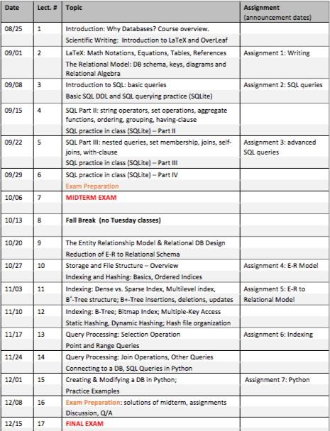
Tentative Schedule
COMPUTATIONAL AND DATA SCIENCES

Slide 13
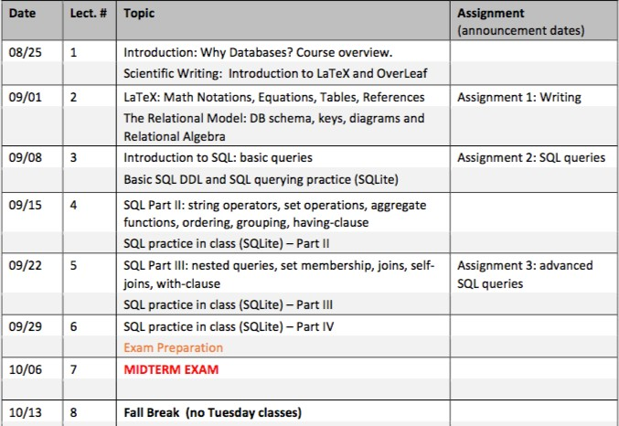
Tentative Schedule
COMPUTATIONAL AND DATA SCIENCES
[1/2]
* You have Monday classes on Tuesday 10/13.

Slide 14
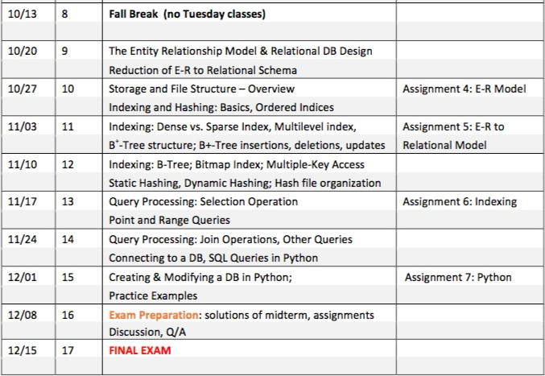
Tentative Schedule
COMPUTATIONAL AND DATA SCIENCES
[2/2]

Slide 15
Who am I?
COMPUTATIONAL AND DATA SCIENCES
Academic Career
Diploma in Electrical & Computer Engineering,
National Technical University of Athens. Greece.
Diploma Thesis: Data Stream Management Tool: Composing Continuous Query Execution Plans
Ph.D. in Computer Science, ECE
National Technical University of Athens. Greece. Knowledge and Data Bases Lab
Recipient of the EU-funded fellowship ‘HERACLEITUS II‘
Ph.D. Thesis: Privacy Preserving Publications of Non-Relational Data
Research Fellow
Research & Innovation Center “Athena”, Greece.
Research Assistant Professor at GGS
George Mason University, Fairfax, VA, USA.
Assistant Professor (tenure-track) at CDS
George Mason University, Fairfax, VA, USA.

Slide 16
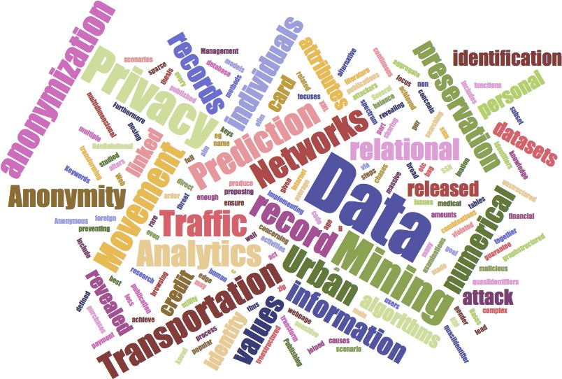
Who am I?
COMPUTATIONAL AND DATA SCIENCES
Research Interests
Data Management
Data Bases
Data Mining
Data Privacy / Anonymity
Urban Data Mining
Movement Analytics
Transportation Networks
Traffic Prediction

Slide 17

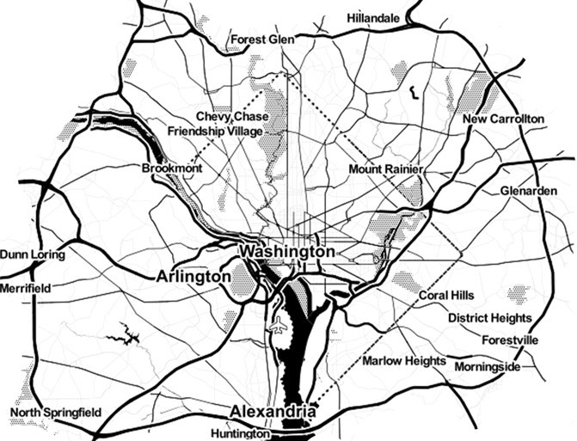
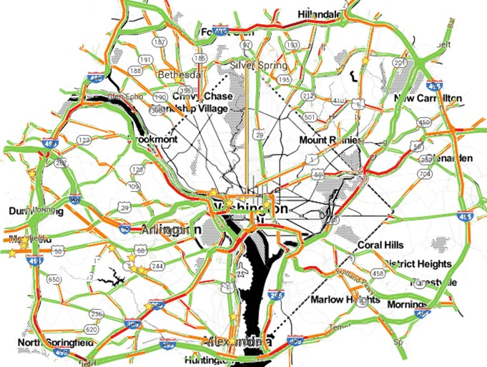
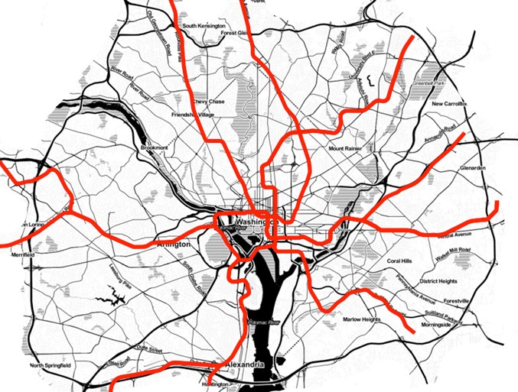


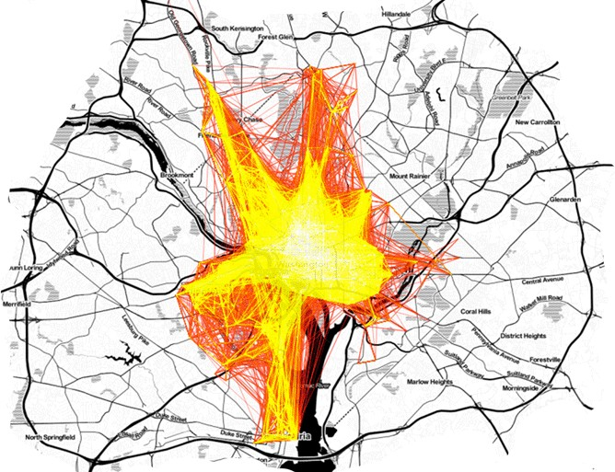
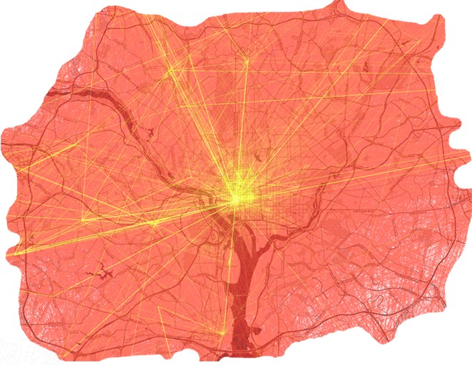
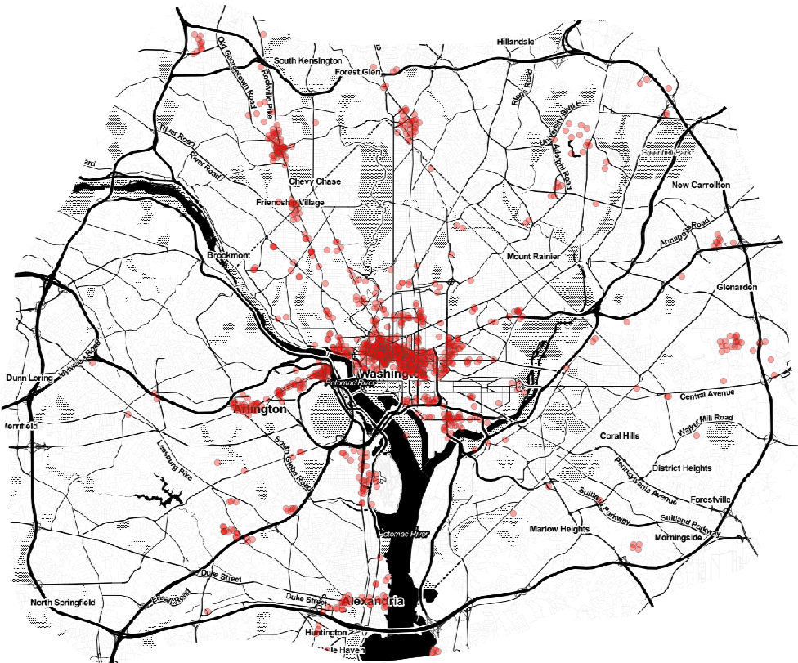



Who am I?
COMPUTATIONAL AND DATA SCIENCES
Research @ GMU
Movement Analytics
NSF – Algorithms on the Field
VDOT
Transportation Networks
Station Profiling
Passenger Volume Prediction
Vehicular Traffic Prediction
Multiple Transportation Modes
Urban Movement Model

Slide 18
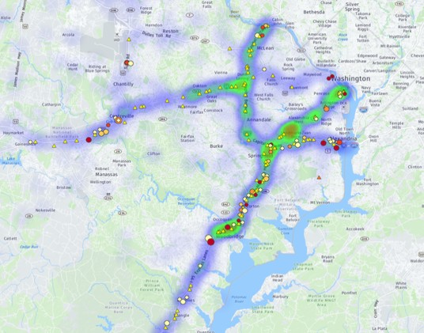
Who am I?
COMPUTATIONAL AND DATA SCIENCES
Research @ GMU
Movement Analytics
NSF – Algorithms on the Field
Transportation Networks
Station Profiling
Passenger Volume Prediction
Vehicular Traffic Prediction
Multiple Transportation Modes
Urban Movement Model

Slide 19
Who am I?
COMPUTATIONAL AND DATA SCIENCES
Research @ GMU
Movement Analytics
NSF – Algorithms on the Field
Transportation Networks
Station Profiling
Passenger Volume Prediction
Vehicular Traffic Prediction
Multiple Transportation Modes
Urban Movement Model

Slide 20
Who are you?
COMPUTATIONAL AND DATA SCIENCES
Now: Introduce yourself ☺

Slide 21
Motivation: Outline
COMPUTATIONAL AND DATA SCIENCES
The flood of Big Data
Why Databases?
Database philosophy
Resources

Slide 22
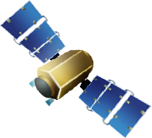







Data is everywhere
COMPUTATIONAL AND DATA SCIENCES
Huge flood of data
Modern technology
New user mentality
2.5 Exabytes of new data every day
New applications
Innovative research
Economic Boost
“$600 billion potential annual consumer surplus from using personal location data” [1]
[1] McKinsey Global Institute. Big data: The next frontier for innovation, competition, and productivity. June 2011.

Slide 23
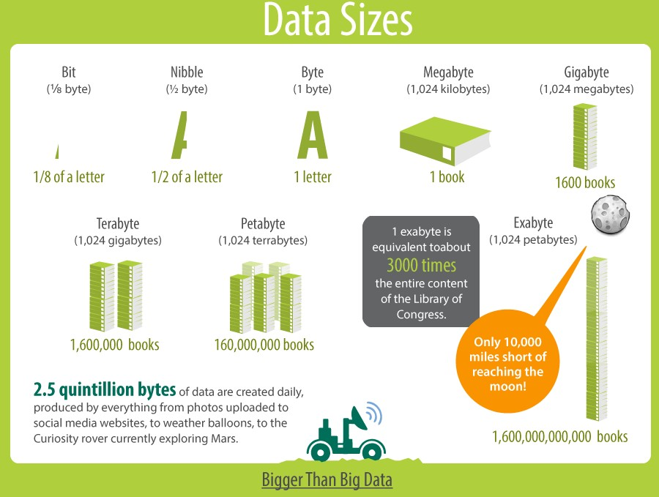
Data Sizes reference
COMPUTATIONAL AND DATA SCIENCES
Scientific Data and Databases: Introduction
23

Slide 24
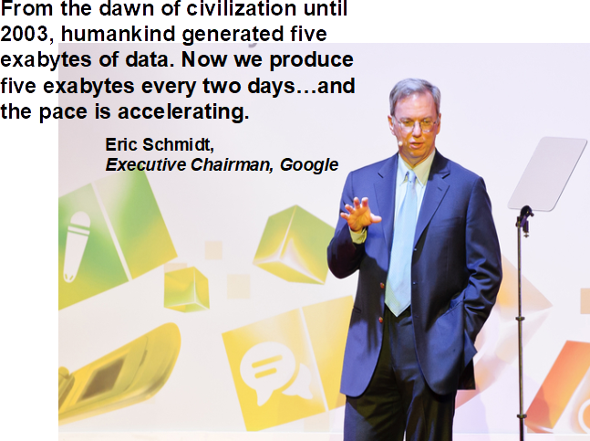
Data production is accelerating
COMPUTATIONAL AND DATA SCIENCES
24

Slide 25
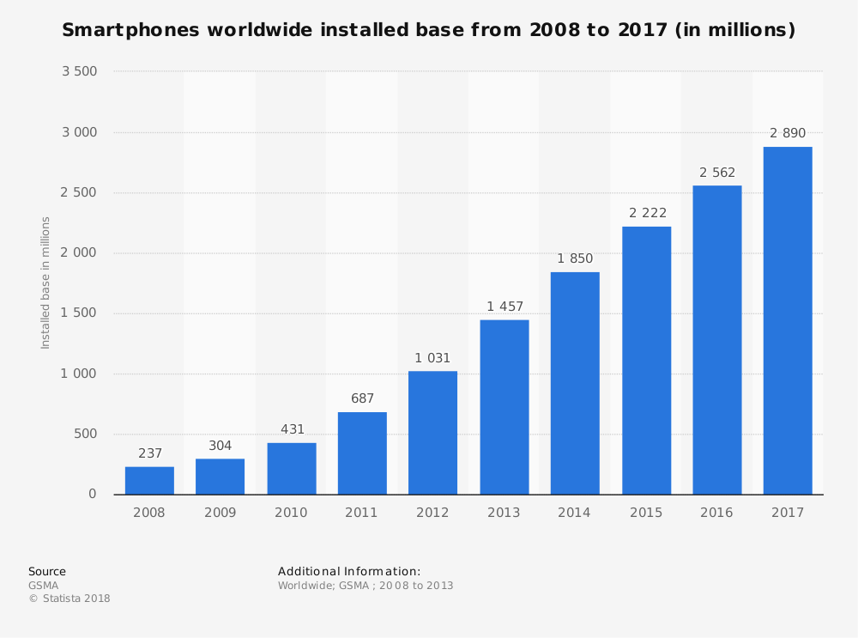
Data production is accelerating
COMPUTATIONAL AND DATA SCIENCES
24

Slide 26
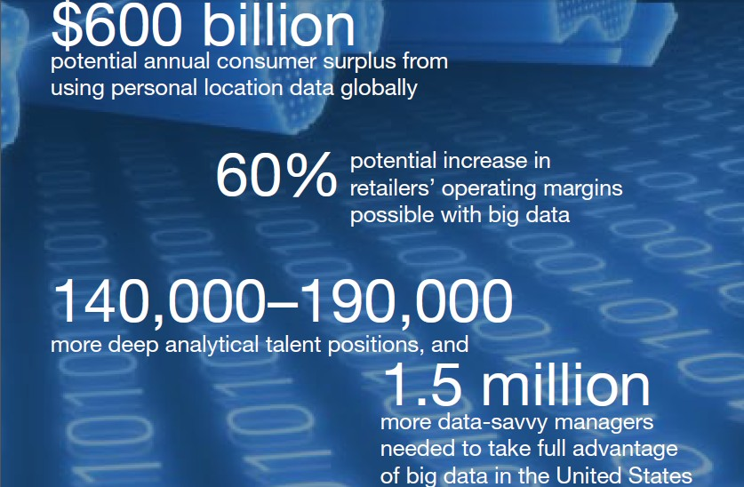
Big Data = $$$
COMPUTATIONAL AND DATA SCIENCES
[1] McKinsey Global Institute. Big data: The next frontier for innovation, competition, and productivity. June 2011.
24

Slide 27
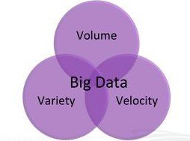

Big Data Hype
COMPUTATIONAL AND DATA SCIENCES
The 3 V’s of Big data…
Volume
Velocity
Variety
24

Slide 28
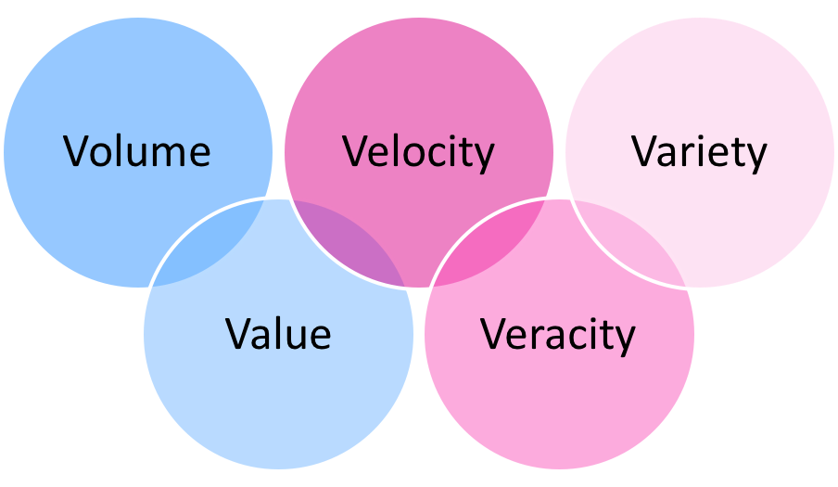
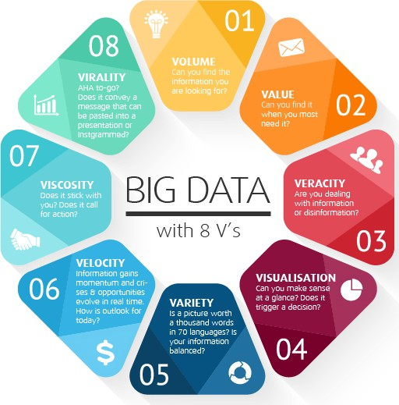
Big Data Hype
COMPUTATIONAL AND DATA SCIENCES
The 3-ish V’s of Big data…
Volume
Velocity
Variety
Veracity
Variability
Visualization
Value
…
24

Slide 29


Big Data Hype
COMPUTATIONAL AND DATA SCIENCES
Big Data analytics is a fancy new word for Knowledge Discovery in Databases!
KDD has focused on large data for decades:
VLDB since 1975
Big Data is not new
24

Slide 30
Big Data Hype
COMPUTATIONAL AND DATA SCIENCES
Big Data analytics is a fancy new word for Knowledge Discovery in Databases!
KDD has focused on large data for decades:
But we want to ride the Big Data wave!
High demand on data analysts
Use Big Data for Storytelling!
24

Slide 31
Motivation: Outline
COMPUTATIONAL AND DATA SCIENCES
The flood of Big Data
Why Databases?
Resources
24

Slide 32
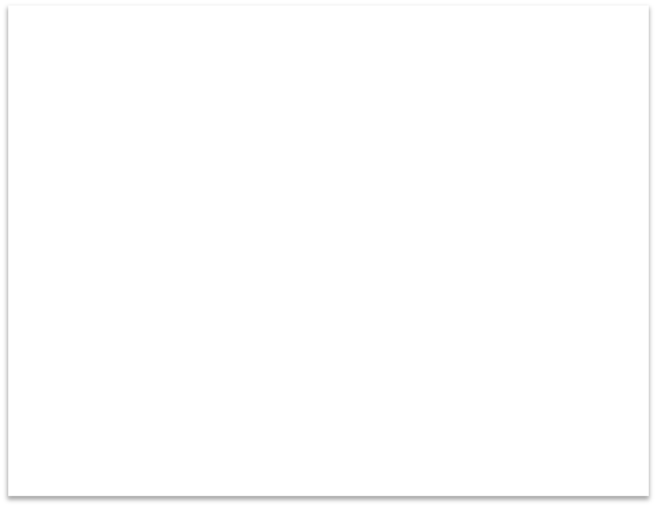



Data is in the center of
COMPUTATIONAL AND DATA SCIENCES
Applications
Data
24

Slide 33

Data is in the center of
COMPUTATIONAL AND DATA SCIENCES
Commerce
Politics
Applications
Data
Health
Sports
Communications
Security
24

Slide 34
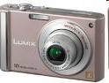

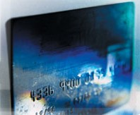
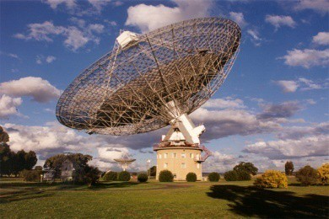


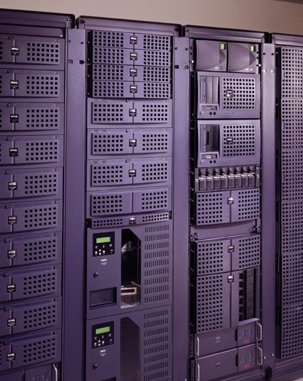
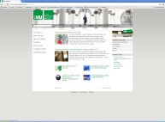


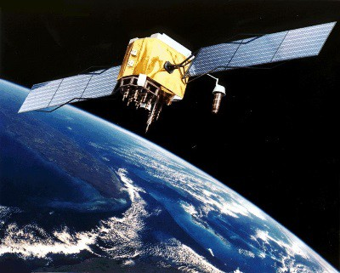


Data collection
COMPUTATIONAL AND DATA SCIENCES
Digital cameras
Banks
Cash register
Astronomy
Telecommunication
Remote Sensing
WWW
Huge amounts of data are collected nowadays from different application domains
Is not feasible to analyze all these data manually
24

Slide 35
How to manage the Data?
COMPUTATIONAL AND DATA SCIENCES
What is a Database?
24

Slide 36
How to manage the Data?
COMPUTATIONAL AND DATA SCIENCES
Database
Data collection, typically stored in secondary memory
Usually, it contains a sample of all data we could possibly collect in the real world.
DBMS
Database Management System: a software package (i.e., collection of programs) designed to define, manipulate, retrieve and manage data in a database.
Database System
DBMS + Database
Scientific Data and Databases: Introduction
Slide from Katerina Doka, Introduction to Databases
36

Slide 37
Who uses databases?
COMPUTATIONAL AND DATA SCIENCES
Scientific Data and Databases: Introduction
Olga Gkountouna
37

Slide 38
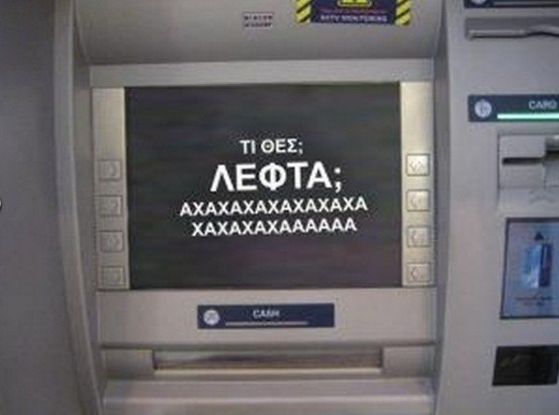
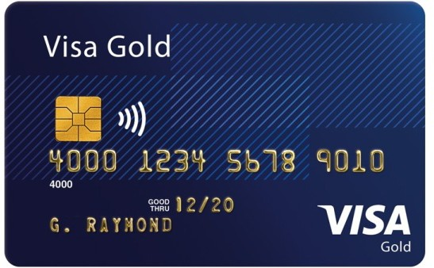




Who uses databases?
COMPUTATIONAL AND DATA SCIENCES
ATM
Slide from Katerina Doka, Introduction to Databases

Slide 39
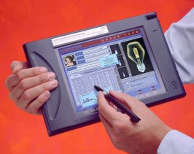

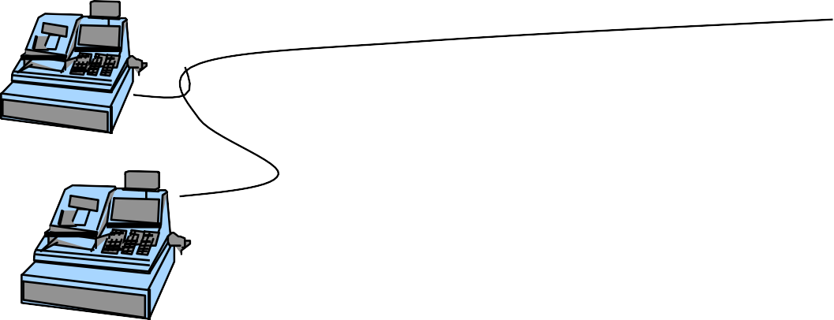
How does a DBMS work?
COMPUTATIONAL AND DATA SCIENCES
Queries and Views
Database
DBMS
Pro | gra | ms
Transactions
Slide from Katerina Doka, Introduction to Databases

Slide 40
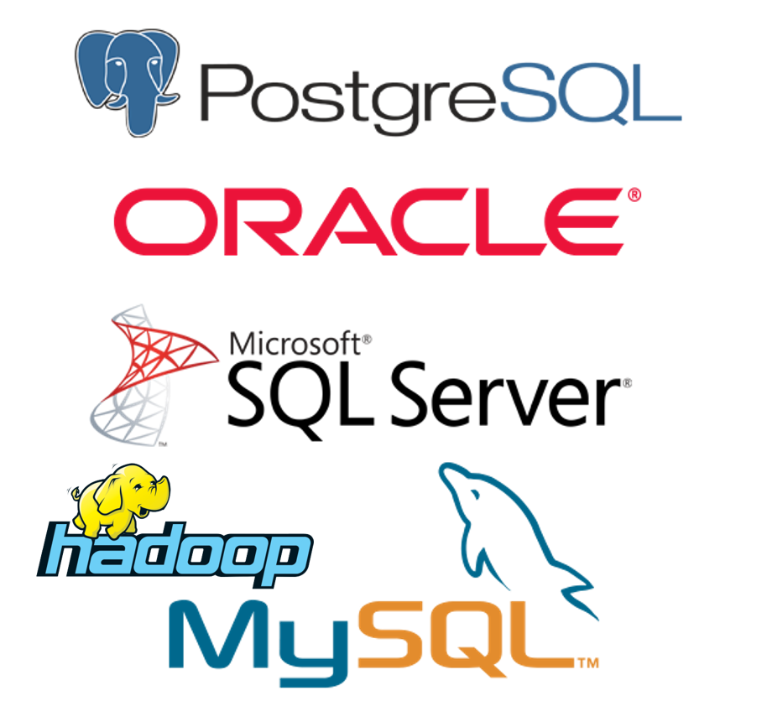

DBMS examples
COMPUTATIONAL AND DATA SCIENCES
Classic relational
Oracle, IBM/DB2, MS SQL-server, Terradata, EMC
PostgreSQL (UCB), mySQL, SQLite
New relational
In-memory, column store, streaming
Non-relational
Graph, geo, scientific
No-SQL
Hbase, Cassandra, MongoDB
DBMS as a service
MS Azure, Google Big Query

Slide 41
Why DBMS?
COMPUTATIONAL AND DATA SCIENCES
Data Modeling
redundancy control,
consistency constraints
Efficient query processing
indexing,
optimization
Operating accuracy
Error recovery - Atomicity
Concurrent access by multiple users
Security issues
access rights

Slide 42
Why not DBMS?
COMPUTATIONAL AND DATA SCIENCES
Cost of investing in software and hardware, as well as training
Its generality may cause time overhead
Not everything that it offers may be needed for a specific application

Slide 43
Scope of this course
COMPUTATIONAL AND DATA SCIENCES
Design and implementation of a DBMS
Design: E-R and Relational Models
Implementation: SQL DDL
Theoretical foundations of the above (relational algebra)
Organization, File storage
Access methods, indexing, hashing
Querying a database
SQL queries, views, transactions
General principles of Database Management systems

Slide 44

Why do I want to learn it?
COMPUTATIONAL AND DATA SCIENCES
[1]
If this means having rare qualities that are much in demand, data scientists are already there. They are difficult and expensive to hire and, given the very competitive market for their services, difficult to retain.
[1] Harvard Business Review. Data Scientist: The Sexiest Job of the 21st Century. October 2012.

Slide 45
Motivation: Outline
COMPUTATIONAL AND DATA SCIENCES
The flood of Big Data
Why Databases?
Resources

Slide 46


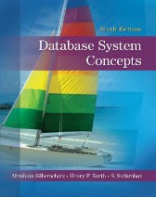
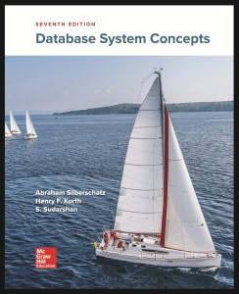

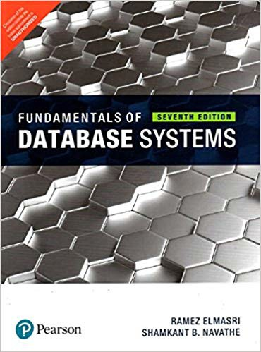
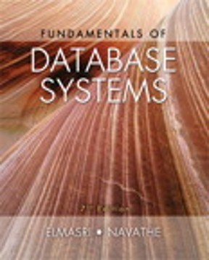
Textbook and Recommended Reference Books
COMPUTATIONAL AND DATA SCIENCES
No Compulsory Textbook
Recommended reference books:
A. Silberschatz, H. F. Korth, S. Sudarshan
Database Systems Concepts
McGraw-Hill, 7th edition
R. Elmasri, S. B Navathe Fundamentals of Database Systems Pearson, 7th edition

Slide 47
Suggested reading
COMPUTATIONAL AND DATA SCIENCES
Silberschatz, H. F. Korth, S. Sudarshan
Database Systems Concepts, McGraw-Hill.
Chapter 1 “Introduction”
TODO before next class:
Create a free online account with Overleaf. www.overleaf.com

Slide 48
Resources online
COMPUTATIONAL AND DATA SCIENCES
Introduction to Databases class by Jennifer Widom, Stanford
http://www.db-class.org/course/auth/welcome
LaTeX tutorials
https://www.overleaf.com/learn/latex/Tutorials
https://www.latex-tutorial.com/tutorials/
List of LaTeX Math Symbols
https://www.caam.rice.edu/~heinken/latex/symbols.pdf

